Slide 1
Proc Compare
A Great Proc When used Right

Slide 2
Contents
What Proc Compare Does
Syntax
Cautions
Examples
Approaching Datasets
Advantages/Disadvantages
Conclusions

Slide 3
What to use Proc Compare for?
Proc Compare is used to, as the name implies, compare 2 datasets
Proc Compare can compare:
Different Observations
Number of variables
Row Totals
Different Formats
What it CANNOT compare
Same Observations
Same Formats

Slide 4
Proc Compare Syntax
As seen in the Syntax, Proc Compare is a relatively light Proc with 2 main parts.
Base=dataset1, the dataset we want Proc Compare to consider the reference dataset
Compare=dataset2, the dataset we want to compare dataset 1 against.

Slide 5
Proc Compare Additional Syntax
Out= produces a dataset of our difference in observations
List displays the name of variables that are different between 2 datasets (not a part of the default)
Criterion=
Allows the user to change the criterion for numeric comparison

Slide 6
Cautions
Proc Compare works on a row by row basis. Thus if 2 datasets are exactly the same, but are sorted differently they will be flagged as differences
With this in mind, what happens when a dataset has 1 observation different?
Proc Compare’s default for max differences printed is 50, if this number is exceeded it will stop displaying differences
With this in mind it can also be seen that Proc Compares can grow to be quite large if a dataset is extremely different

Slide 7
Time for examples!
For this example, imagine you are working for a teacher that is expecting a new dataset to teach the alphabet the teacher currently uses dataset 1, and you are now receiving dataset2

Slide 8
Dataset 1-Base_Alphabet
create table WORK.BASE_ALPHABET( bufsize=65536 ) (
letter char(1),
Alphabet_position num,
word char(12) label='word that starts with this letter',
percent_chance num,
project_due_date num format=DATE9.
);

Slide 9
Dataset 2-Compare_Alphabet
create table WORK.COMPARE_ALPHABET( bufsize=65536 )(
letter char(1),
Alphabet_position num,
word char(9) label='word that starts with this letter',
percent_chance num format=5.3,
project_due_date num format=MMDDYY10.,
row_num num,
new_flag num format=5.2
);

Slide 10



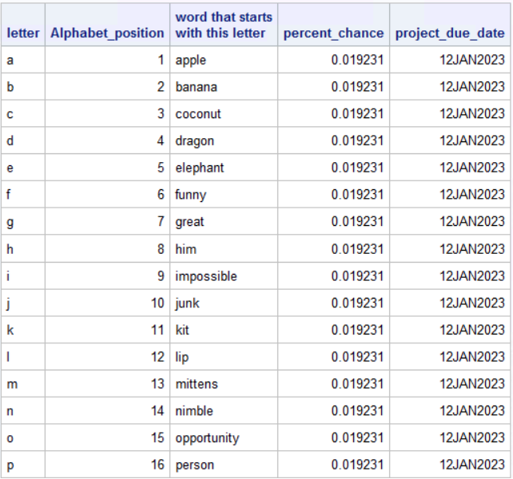
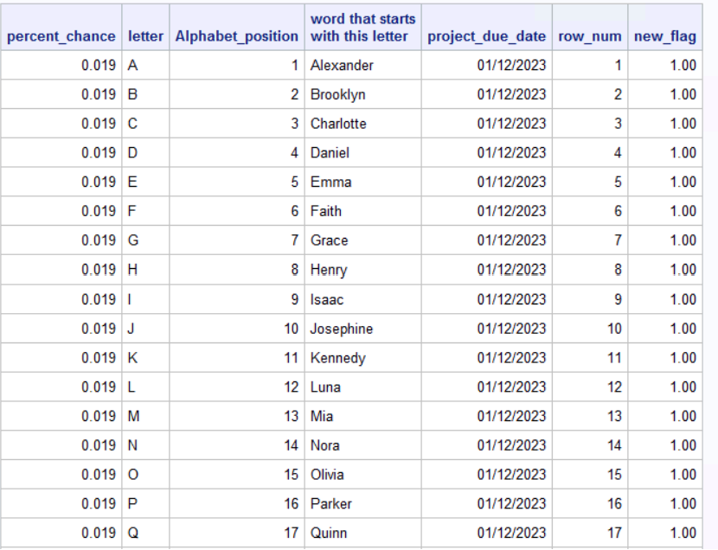


Datasets used for examples
Dataset 1
Dataset 2

Slide 11

Scenario 1

Slide 12
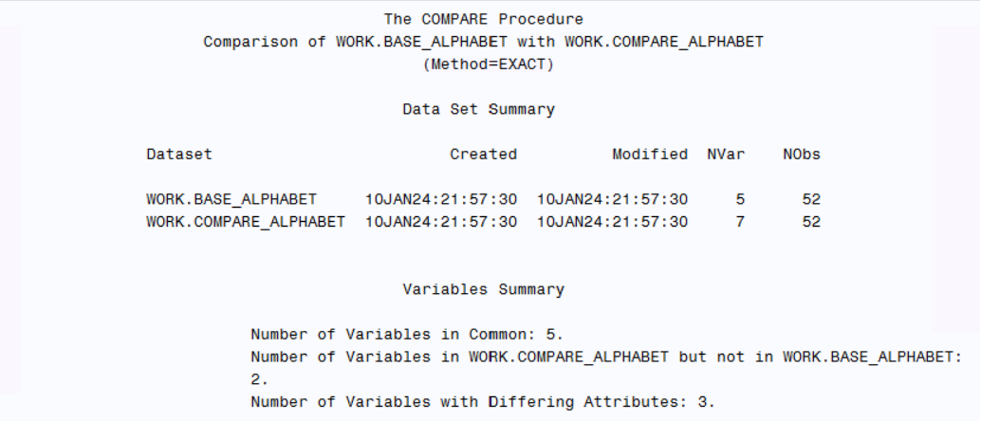
Page 1

Slide 13
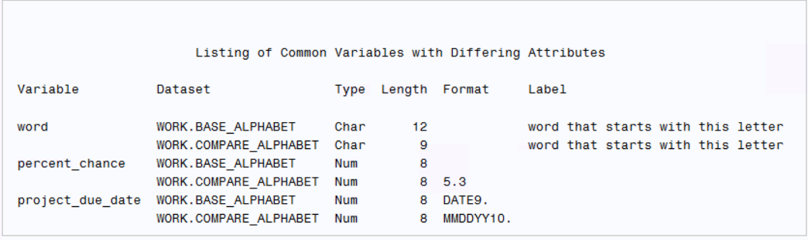
Page 2

Slide 14
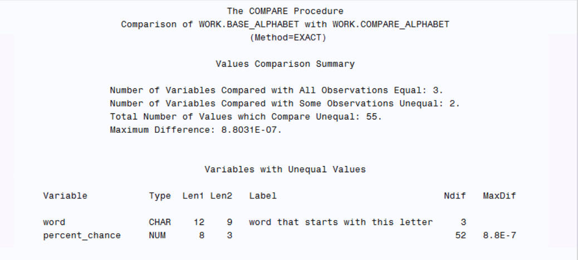
Page 3

Slide 15
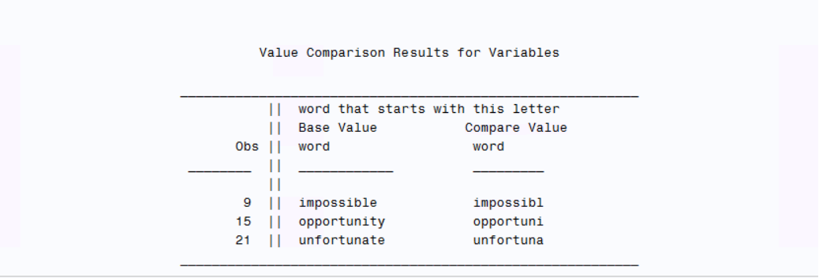
Page 4

Slide 16
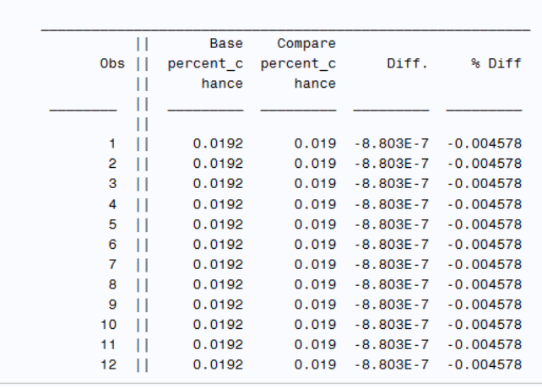
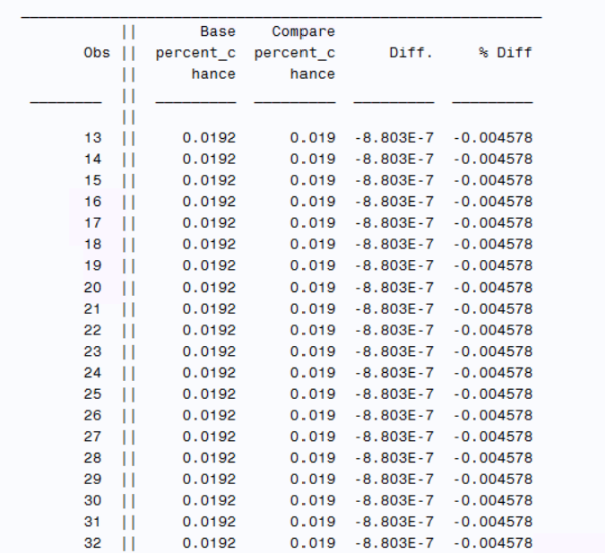
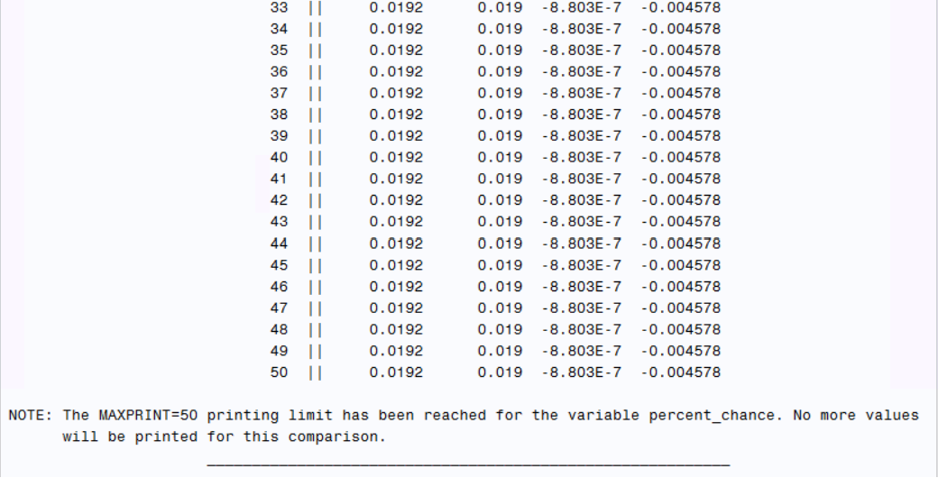
Page 4/5

Slide 17

NOTICE
Despite pointing out the fact 2 variables are not in base_alphabet, the 2 variables are not reported we fix this using the list syntax

Slide 18
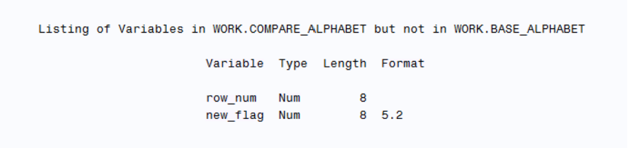
List page

Slide 19
Scenario 2
Imagine dataset 2 was accidentally sorted first, what would happen?

Slide 20
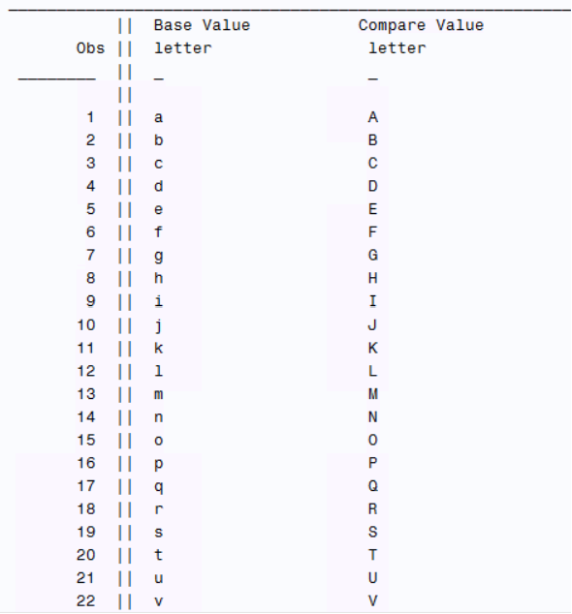
LOTS of output

Slide 21
Solution
Sort the dataset by the same variable

Slide 22
Scenario 3
What if we do not want to analyze the differences at the .0001 level? What if we wanted to look at the change at the .001 level?

Slide 23
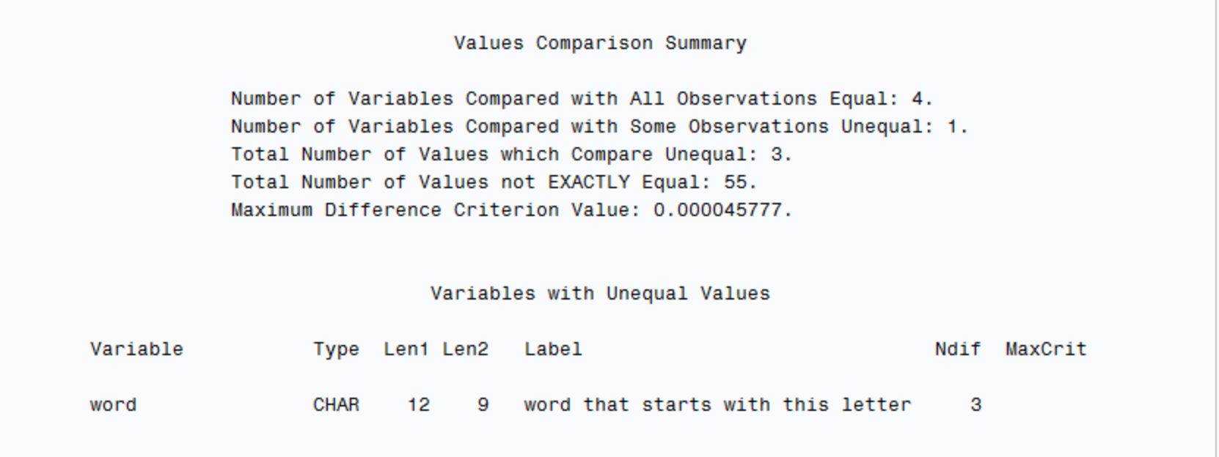
New output

Slide 24
Scenario
Oh no! The new datamakers forgot about the letter c! What happens to the output?

Slide 25
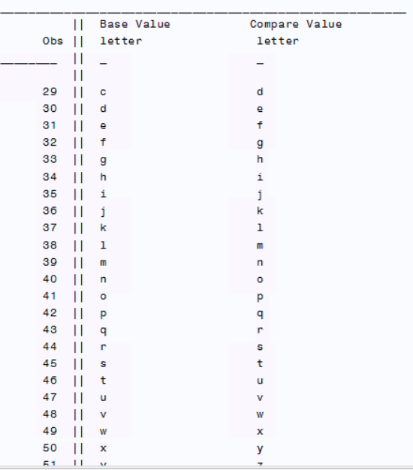
Output

Slide 26
How to approach different types of datasets
Sorted Datasets with equal observations: Feel free to look at all of proc compare output
Datasets with a different number of observations: approach differences cautiously, stick to format comparison
Datasets that should be the same but have a lot of differences: Only use for comparing formats

Slide 27
Proc Compare Advantages
Great at finding differences in format
Great at finding differences in variable name
Great at comparing the differences allocated to format changes

Slide 28
Proc Compare Disadvantages
Proc Compare being strictly row to row comparisons can lead to people making false conclusions about the differences within their data
Having one extra observation destroys the observation comparison feature
Multiple different observations throughout different variables will blowup output
Outside of its format comparison feature, most comparisons it does are better founded through merging

Slide 29
Conclusions
Proc Compare is a great Proc if you know exactly what you want out of it.
Although it can be quite limiting in its row observations, its format comparison and list tools are extremely efficient.

